Slide 1


MID-TERM PROJECT UPDATE
Transformer for Time Series Anomaly Detection
Building and evaluating a compact, efficient model for temporal data
GROUP 7
OUR GOAL
Julian & Lars
To develop a transformer-based model benchmarked against strong classical & neural baselines

Slide 2

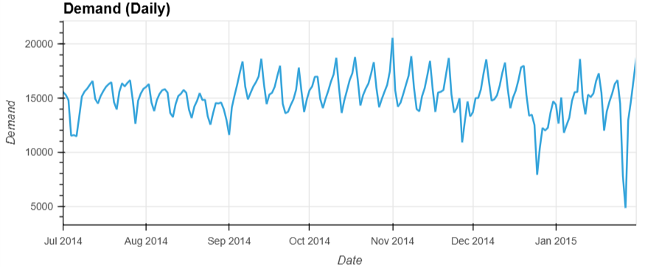
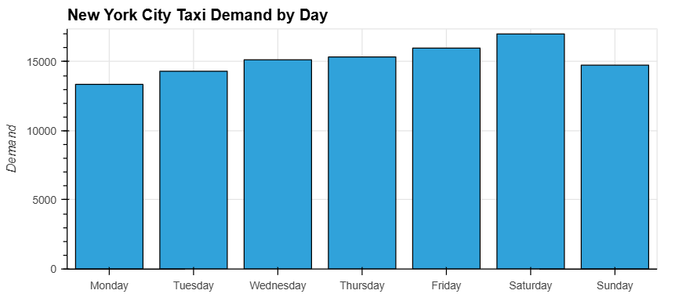
Problem & Current Focus
•
Task: Univariate time series anomaly detection
•
Dataset: NAB NYC Taxi (trips every 30 mins)
•
Characteristics: Strong daily/weekly seasonality with rare anomalies (e.g., holidays, marathon)
•
Why this setup? A well-known benchmark simplifies comparison and serves as an ideal sandbox for testing evaluation pipelines
Figure: Weekly seasonality in NYC taxi demand

Slide 3








Data & Experiment Pipeline
Data Handling
Experiment Automation
Evaluation Metrics
Implemented a data loading and preprocessing pipeline
Time-based split (70/30) with correct DatetimeIndex parsing ensures no data leakage
Automated train/test/scoring pipeline for each model
Ground-truth labels integrated for evaluation
Designed for Dockerization and reproducible experiments
Using Precision, Recall, F1, and AUC-ROC
Added Range Metrics to handle contiguous anomaly intervals more fairly

Slide 4

Classical Baselines Implemented
Rolling Z-Score
Uses a 1 day window. Large Z-scores are flagged. While simple, it is highly sensitive to threshold settings and often weak
ARIMA Residuals
ARIMA(2,1,2) one-step forecast. Anomalies are large residuals. The scores are informative but noisy, making thresholding tricky
Isolation Forest
Tuned with contamination ≈ 0.01. It detects 2/3 of labeled events with the best F1 range and AUC-ROC. Current strongest classical baseline

Slide 5

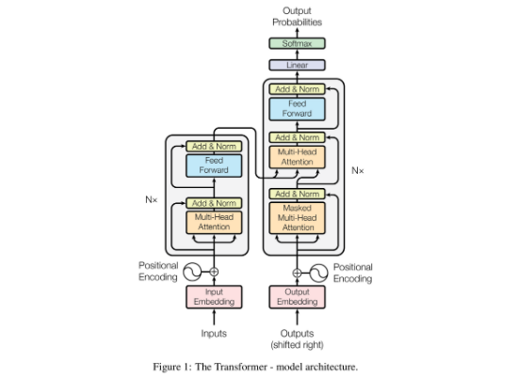
Neural Baseline & Transformer Work
LSTM Forecasting Baseline
•
Architecture: Univariate LSTM with a 72-step lookback window predicting the next value
•
Scoring: Anomaly score = Absolute forecast error
•
Behavior: Very few alarms -> high precision but lower recall compared to Isolation Forest
Transformer Progress
•
Mini-transformer built from scratch (encoder-style)
•
TranAD deployed and running on
Figure: Transformer Architecture (Reference)
University scientific cluster for heavy runs

Slide 6



Key Insights So Far
Metrics & Labels
Threshold Sensitivity
Model Roles
Given the few labeled anomalies, point metrics are unstable
Range-based metrics provide a more intuitive and fair evaluation of model performance
Small changes in thresholds (Z-score limits, contamination rates) lead to massive swings in precision/recall
Robust thresholding is a key challenge
ARIMA is too noisy for this dataset
LSTM is conservative (high confidence, low quantity)
Isolation Forest offers the best trade-off so far

Slide 7
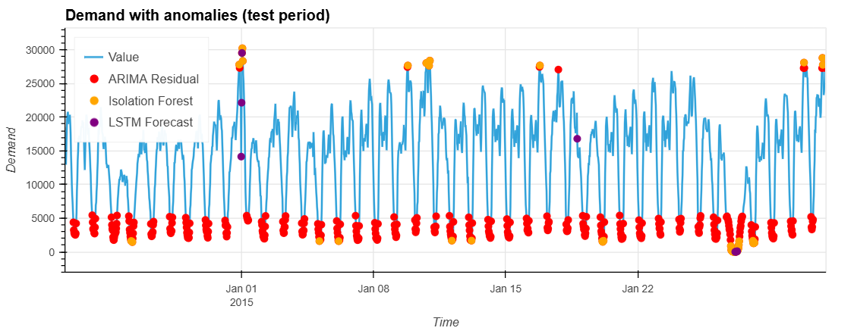
Baseline Anomaly Detection

Slide 8
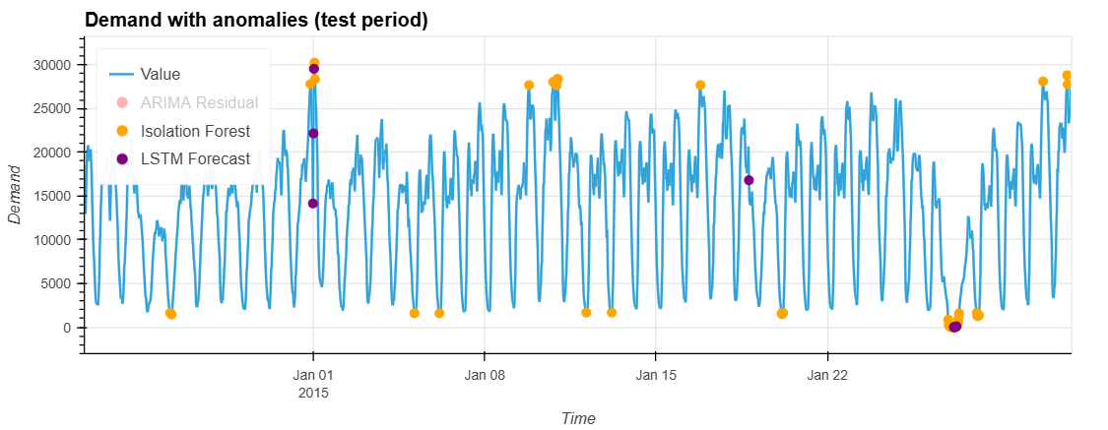
Baseline Anomaly Detection

Slide 9


Next Steps
Transformer Experiments
Stronger Baselines & Outcome
→
Train and tune transformer on NYC Taxi & additional NAB datasets
→
Add features (lag, hour-of-day, day-of-week) to Isolation Forest & LSTM
→
Find the right embeddings: Sinusoidal vs. Time2Vec
→
Fair comparison of classical, LSTM and transformer-based methods
→
Test strategies: Reconstruction vs. Forecasting vs. Hybrid scoring
→
Goal: End-to-end demo with visual anomaly overlays and a fair performance summary

